Slide 1
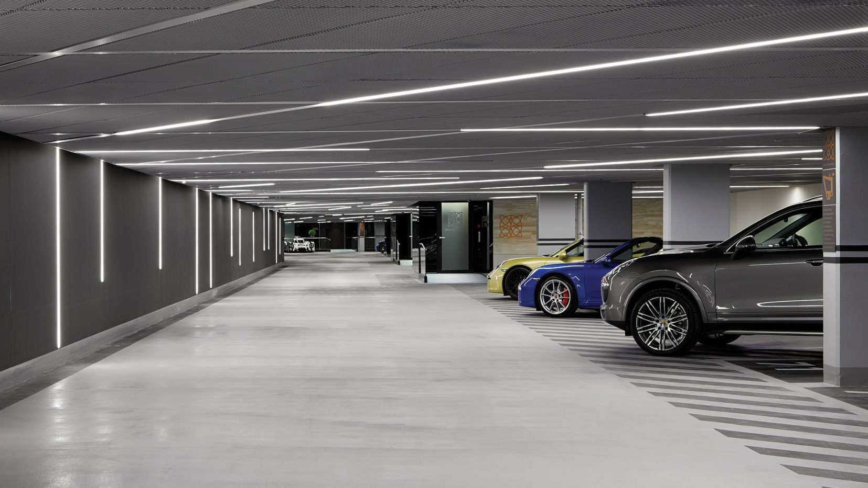
INTELIGENT PARKING SYSTEM
Graduate: Alin-Constantin Cibotariu
Coordinator: Lect. Dr. Dan Popa

Slide 2
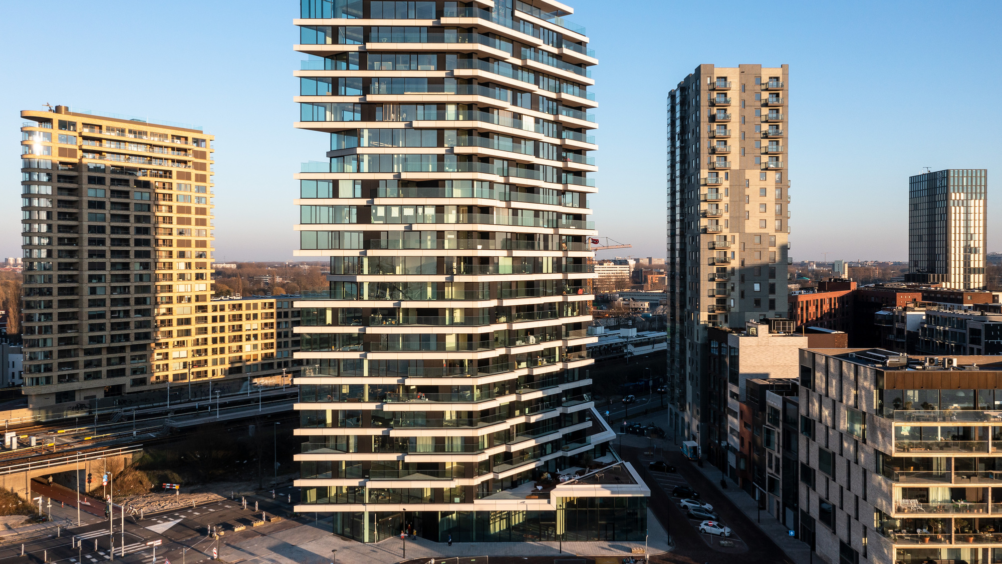
Why do we need an intelligent parking system? (free discussion)

Slide 3
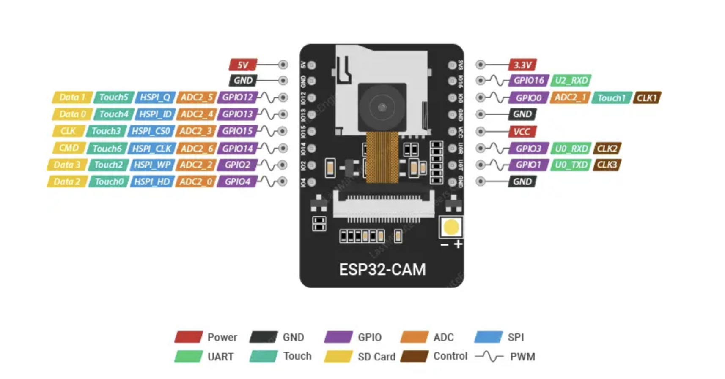
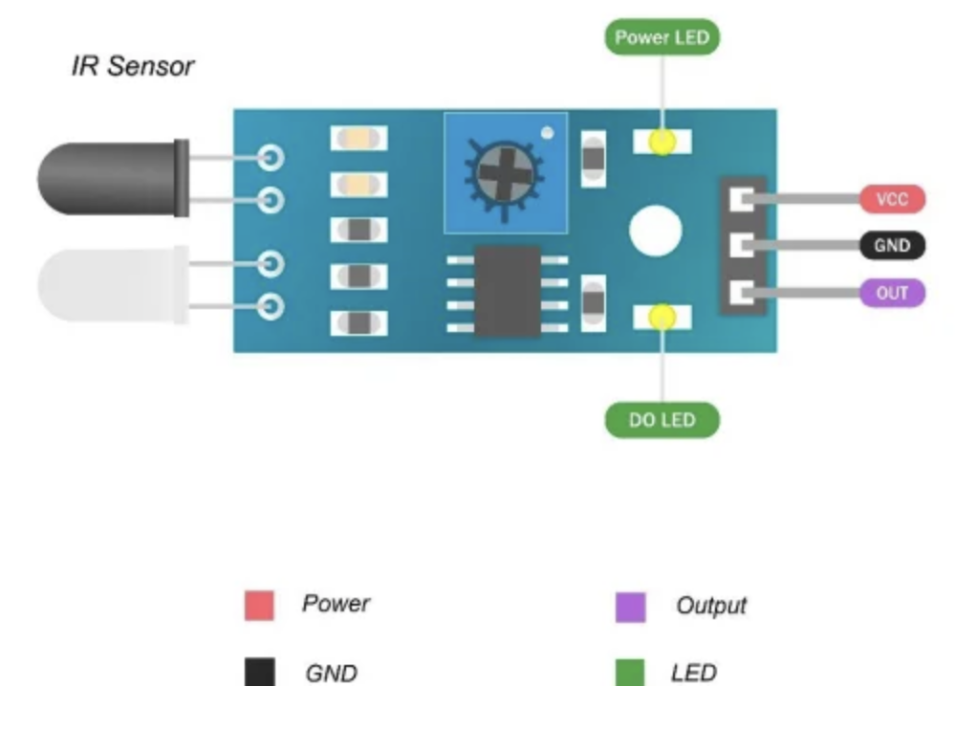
Componests: 1. Camera: ESP32-CAM and IR motion sensor. This camera sends the images to once the sensor triggers to OCR (PC) via HTTP post.

Slide 4
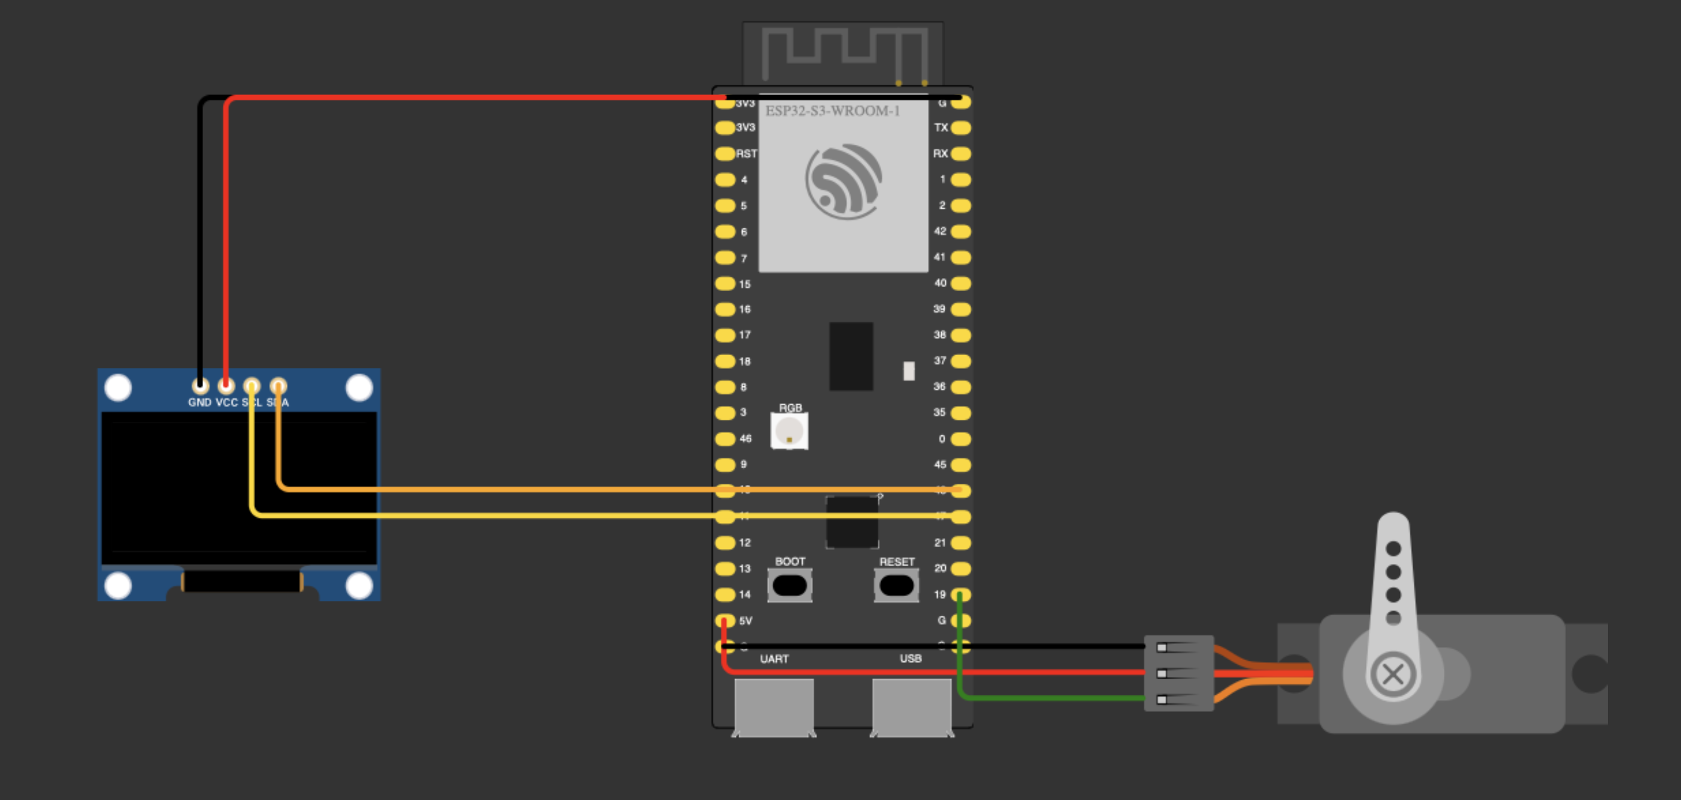
Component: 2. Barrier (servo) with display, it runs a local server which “listens" via 8080 port the data received after number plate recognition via HTTP post form PC.
Servomotor PWM
5 volți alimentat din sursa externă cu ground comun
Ecran OLED
3,5 volti alimentat de pe ESP32
ESP32 S3
Procesor DUAL CORE 240 MHZ
Ram 512KB RAM
Flash 16MB

Slide 5
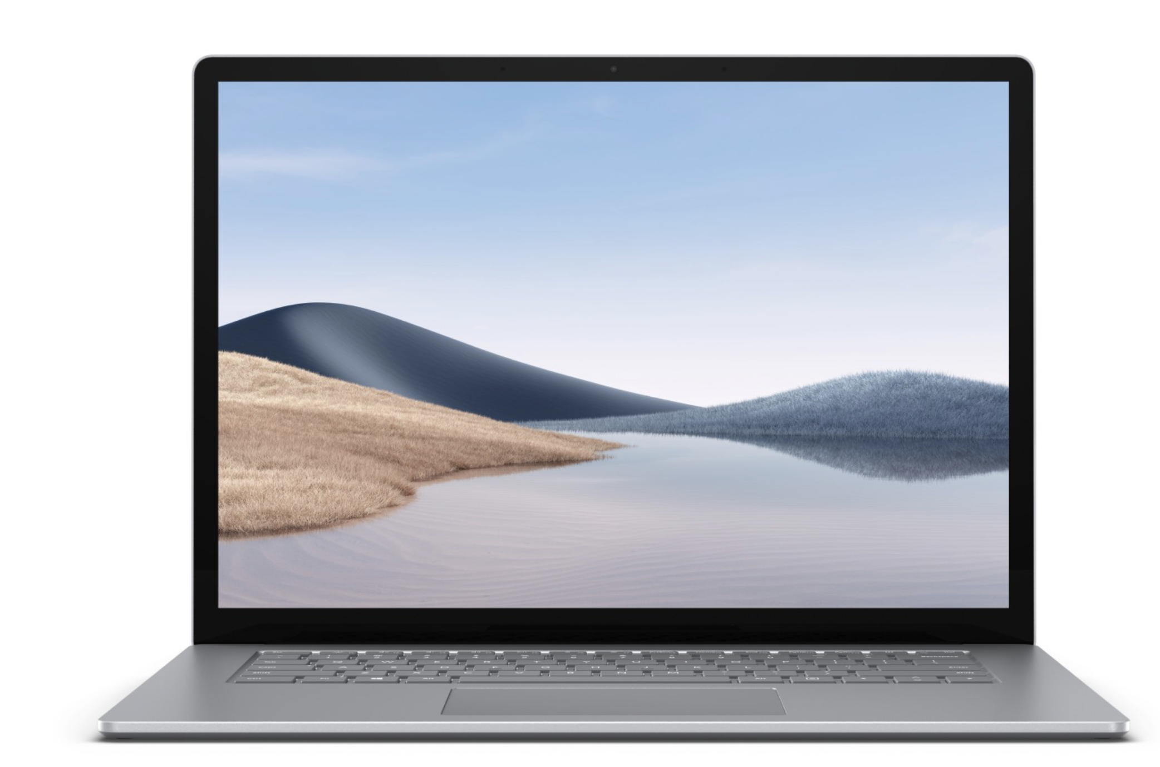

3. OCR Processing on PC using the Tesseract library with Python
Tesseract is an open-source optical character recognition (OCR) engine developed by Google.
It allows text extraction from scanned images or photographs, being used for automatic recognition of license plates, documents, etc.
In this project, pytesseract is used to call Tesseract and extract the license plate number from the processed image.

Slide 6
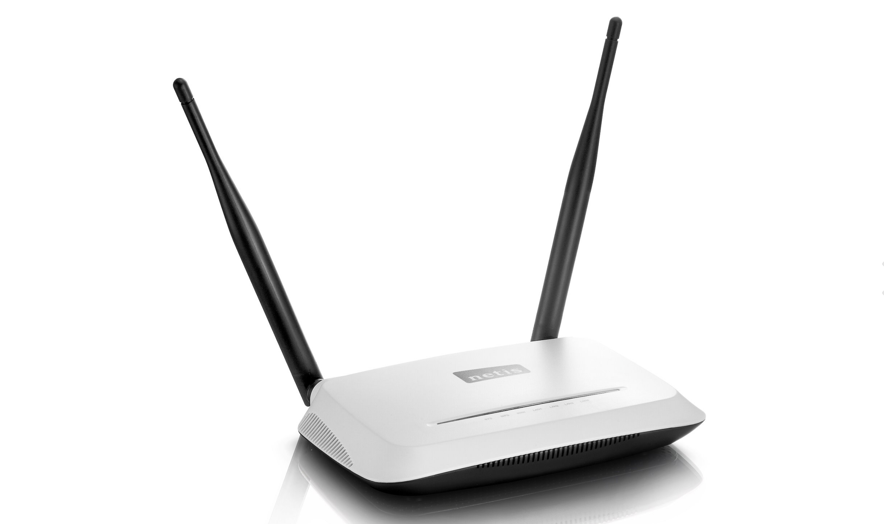
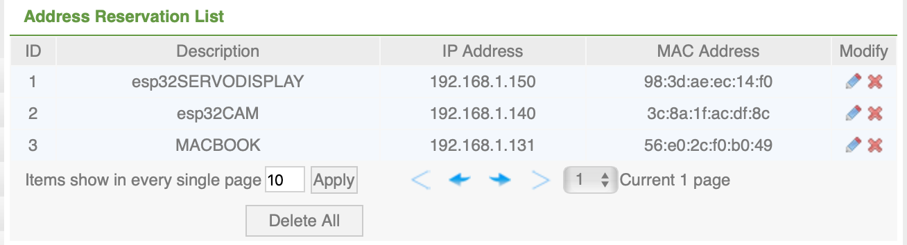
4. Local WIFI network where every device has it’s own reserved IP address

Slide 7
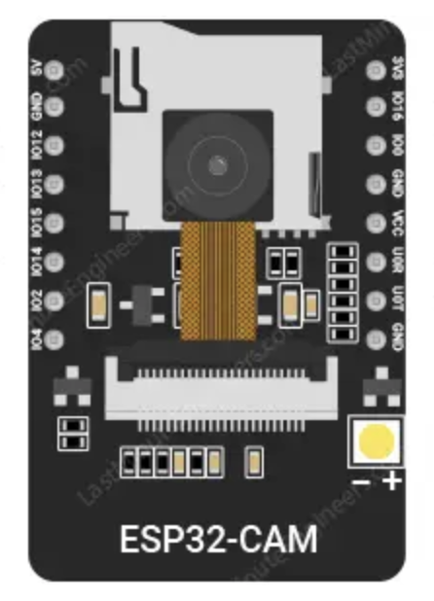
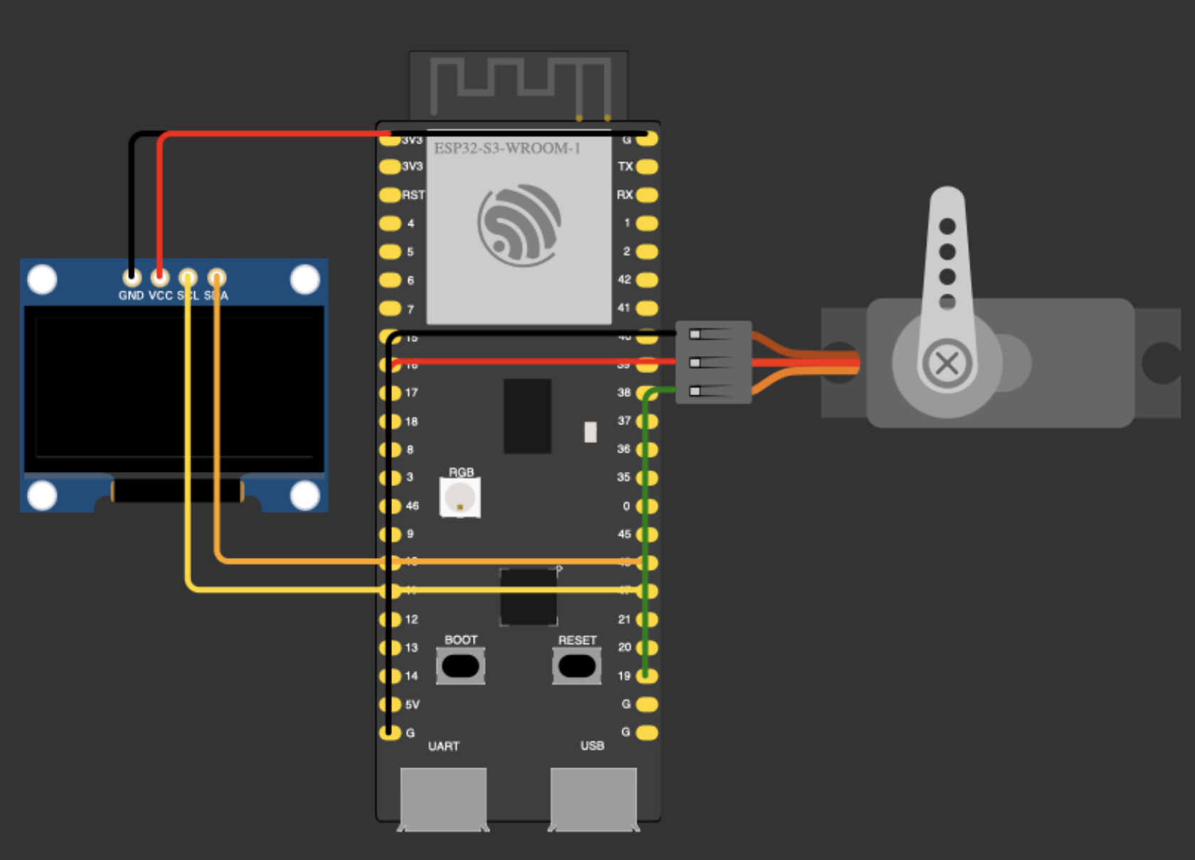
General System Assembly

Slide 8
Practical Demonstration
The evaluation committee will provide two examples of license plate numbers: one will be authorized, and the other unauthorized.

